Slide 1
Design PatTern
ABDUL RAHEEM RIHAM AHAMED
HND COMPUTING IDM

Slide 2
Contents
What is design pattern
Usage of design pattern
Principle of design pattern
Types of design
Reference

Slide 3
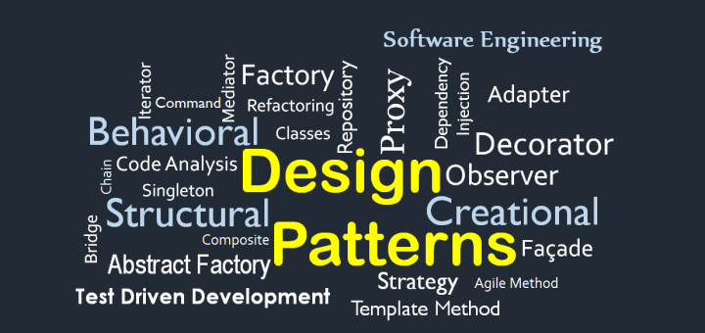
What is Design pattern
Notes:
Design patterns represent best practices used by experienced object-oriented software developers. Design patterns are solutions to common problems that software developers face during software development. Many software developers came up with these solutions through trial and error over a considerable period of time.

Slide 4

Usage of Design pattern
Common platform for developers
Best Practices
Notes:
Common platform for developers
Design patterns provide standard terminology and are specific to a particular scenario. For example, a singleton design pattern means to use an object, so all developers familiar with a design pattern will use an object and can tell each other that the program follows a singleton pattern.
Better practices
Design patterns have evolved over time and provide the best solutions to certain problems during software development. By learning these patterns, inexperienced developers can learn to design software quickly and easily.

Slide 5

Principle of Design pattern
There are three principle in design pattern.
Principle of Decoupling
Ensuring Cohesion
Open-closed Principle
Notes:
Principle is Is a process guide

Slide 6
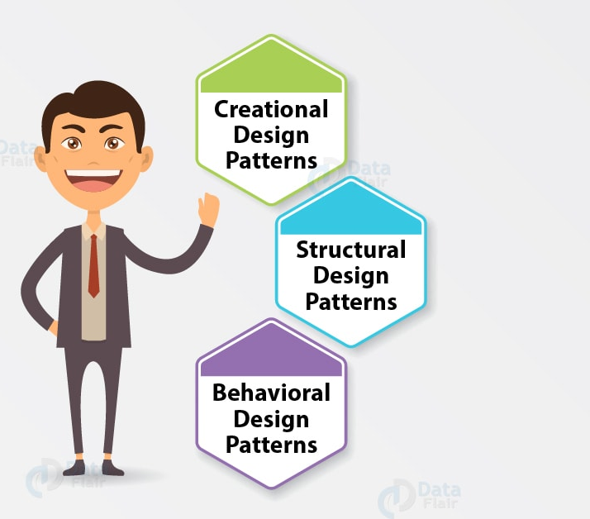
Types of Design
Creational Design pattern
Structural Design pattern
Behavioral Design patterns.

Slide 7
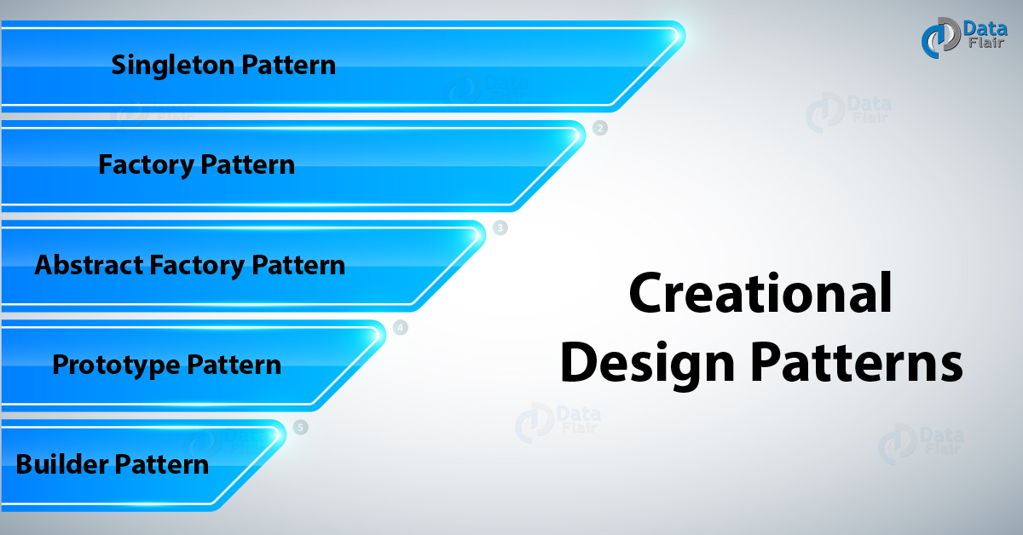
Creational patterns.
Abstract Factory
Creates an instance of several families of classes
Builder
Separates object construction from its representation
Factory Method
Creates an instance of several derived classes
Object Pool
Avoid expensive acquisition and release of resources by recycling objects that are no longer in use
Prototype
A fully initialized instance to be copied or cloned
Singleton
A class of which only a single instance can exist
Notes:
These design patterns have to do with creating classes. This pattern can be divided into class creation patterns and object creation patterns. While class creation patterns use inheritance effectively in the instantiation process, object creation patterns use delegation effectively to get the job done.

Slide 8
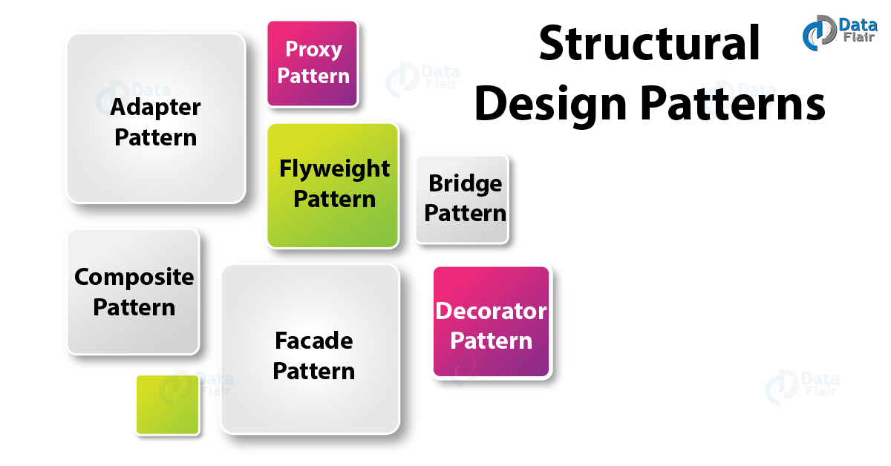
Structural patterns.
Adapter
Bridge
Composite
Decorator
Façade
Flyweight
Private Class Data
Proxy
Notes:
These design patterns have to do with the composition of classes and objects. Structural class building patterns use inheritance to construct interfaces. Structural object patterns define ways of assembling objects for new functionality.

Slide 9
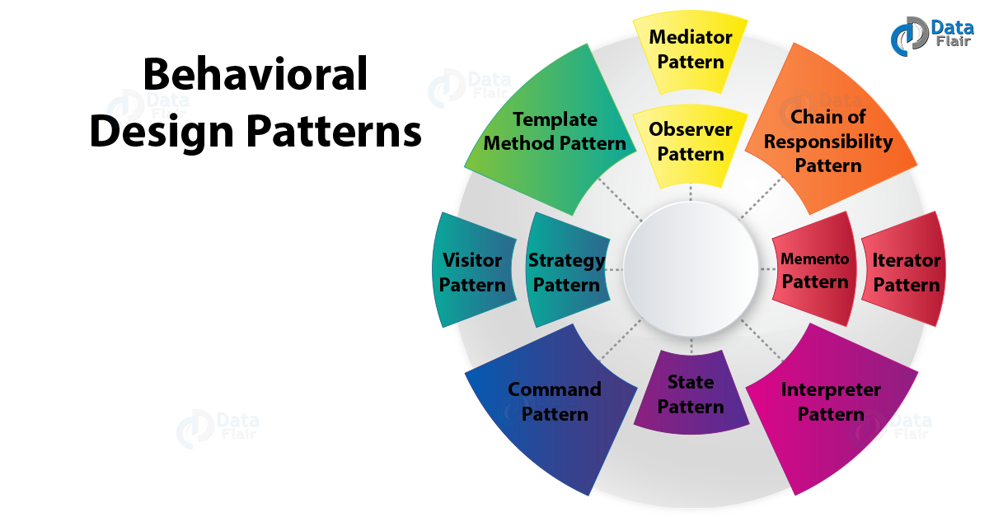
Behavioral patterns.
Chain of responsibility
Command
Interpreter
Iterator
Mediator
Memento
Null Object
Observer
State
Strategy
Template method
Visitor
Notes:
These design patterns have to do with the communication of Class objects. Behavioral patterns are those patterns that are more specifically related to communication between objects.

Slide 10
THANK YOU

